Slide 1


State transition diagram, Examples of languages accepted by DFA Session No.: 4 Course Name: Theory of Computation Course Code: R1UC428T Instructor Name: Arvind Kumar Duration: 50 mins

Slide 2

Review of the key concepts of session no. #3
Introduction to DFA with example
Real-life example of DFAs

Slide 3
Pre-Session Quiz
Attempt all question of pre-lesson assessment

Slide 4



Opening: Engaging Questions “If I give you a machine with only a few states and arrows between them, how can you tell what strings it will accept?”
Example??
Discuss

Slide 5
At the end of this session, you will be able to:
Learning Outcome 1: Construct and analyze State Transition Diagrams
Learning Outcome 2: Differentiate languages accepted by various DFAs

Slide 6
Session Outline
Recap
Opening Questions
State Transition Diagrams
Examples of languages accepted by DFA
Conclusion

Slide 7
State Transition Diagram
A state transition diagram for a DFA (Deterministic Finite Automaton) is a visual representation of how a DFA changes states based on input. It uses nodes to represent states and directed edges (arrows) labeled with input symbols to show transitions between states.

Slide 8
Category 1: Accept Only the Given Input
DFA accepts only one specific input string and rejects all others. For Examples
Accepts only abbbbccc
Accepts only 011010010
Accepts only 101010
DFA Example: 1.1
Design a DFA over ∑ = {0, 1} that accepts only the input string “10”.
Solution:
In the above example
Regular Expression = 10
Language of Accepted Strings = {10}
Some Rejected Strings = {ε, 0, 1, 11, 00, 101, 100, 110}

Slide 9
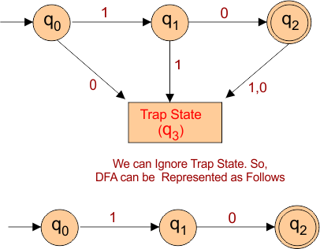
DFA that accepts only the input string “10” is given below
Note: q3 is a dead state, at q3, for inputs “0” and “1”, it’s a self-loop.

Slide 10
In the above DFA, 5 tuples of DFA are given below
States: {q0, q1, q2,q3} refers to the set of states
Input Alphabet: {0,1} refers to the set of input alphabets
Transition Function (δ): refers to the transition function, which is defined as
δ (q0, 0) = q3
δ (q0, 1) = q1
δ (q1, 0) = q2
δ (q1, 1) = q3
δ (q2, 0) = q3
δ (q2, 1) = q3
δ (q3, 0) = q3
δ (q3, 1) = q3
Initial State: q0 refers to the initial state
Final State: {q2} refers to the set of final states
Note: q3 is a dead state.
States | 0 | 1
→ q0 | q3 | q1
q1 | q2 | q3
*q2 | q3 | q3
q3 | q3 | q3

Slide 11
Category 2: Starts and Ends With
DFA accepts strings that start with a specific substring and/or end with a specific substring. For Examples
Starts with 01
Ends with 000
Starts with a, ends with bb
Starts and ends with the same symbol
DFA Example: 2.1
Construct a DFA that accepts all the strings over the alphabets ∑ {0,1} that start with “0”.
Solution:
The given question provides the following
Regular Expression = 0(0+1)*
Language of Accepted Strings = {0, 01, 00, 010, 011, 000, 001,…, }
Some Rejected Strings = {ε, 1, 11, 101, 1001, 110}
Let’s draw the DFA, which accepts all the strings starting with “0”.

Slide 12
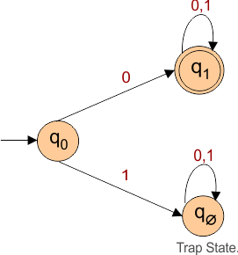
Let’s draw the DFA, which accepts all the strings starting with “0”
.

Slide 13
DFA Description
States = {q0, q1, q∅ }
Input Alphabet = {0, 1}
Initial State = q0
Final States = {q1}
Dead State = q∅ (trap state)
Transition Function δ is defined as:
δ(q0, 0) = q1
δ(q0, 1) = q∅
δ(q1, 0) = q1
δ(q1, 1) = q1
δ(q∅ , 0) = q∅
δ(q∅ , 1) = q∅
Transition Table
Current State | Input 0 | Input 1
→ q0 (initial) | q1 | q2
*q1 (final) | q1 | q1
q∅ (dead) | q2 | q2

Slide 14
Ensure attainment of LOs in alignment to the learning activities: outcomes (1-2)
Learning Outcome 1: construct and analyze State Transition Diagrams
Learning Outcome 2: Differentiate languages accepted by various DFAs

Slide 15
Reflection Time: Question Solving

Slide 16
Discussion on the post session activities
Attempt all Questions of the post-lesson assessment.

Slide 17
Information about the next lesson
Problem solving on DFA

Slide 18

Feedback and Queries

